Slide 1
10-11. More About Objects and Methods
[ECE20016/ITP20003] Java Programming
Notes:
‹#›

Slide 2
Agenda
Constructors
Static Variables and Static Methods
Writing Methods
Overloading
Enumeration As A Class
Packages

Slide 3
Defining Constructors
A special method is called when instance of an object created with new
Create instances (objects)
Initialize values of instance variables
Can have parameters
To specify initial values if desired
May have multiple definitions with different numbers or types of parameters

Slide 4
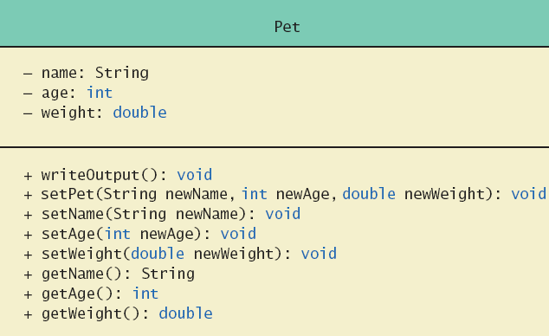
Defining Constructors
Example class to represent pets
Class Diagram for Class Pet

Slide 5
Defining Constructors
class Pet
Note different constructors
public Pet () // default constructor
public Pet (String initialName, int initialAge, double initialWeight)
public Pet (String initialName)
public Pet (int initialAge)
public Pet (double initialWeight)
class PetDemo
Pet yourPet = new Pet ("Jane Doe");

Slide 6
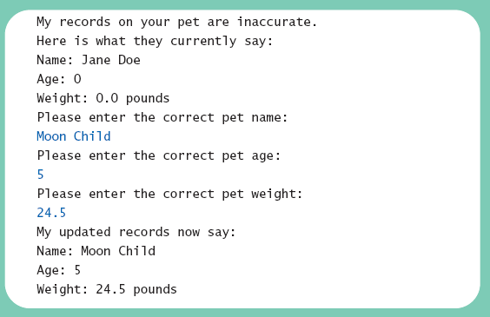
Defining Constructors

Slide 7
Defining Constructors
Constructor without parameters is the default constructor
Java will define this automatically if the class designer does not define ANY constructors
If you do define a constructor, Java will not automatically define a default constructor
Usually default constructors not included in class diagram

Slide 8
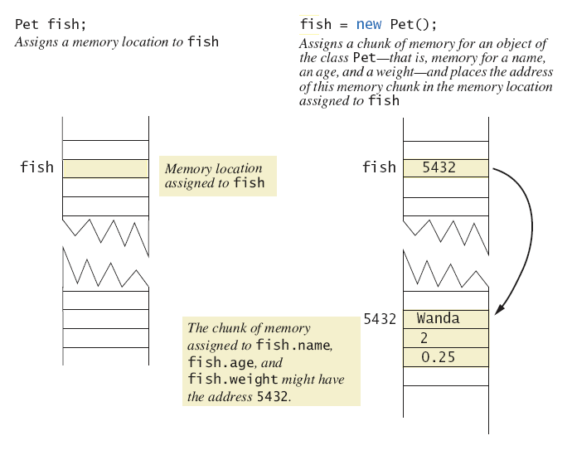
Defining Constructors
A constructor returning a reference
Pet("Wanda", 2, 0.25);

Slide 9
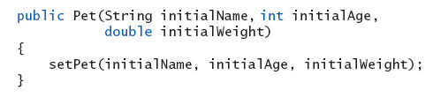
Calling Methods from Other Constructors
Constructor can call other class methods

Slide 10
Calling Constructor from Other Constructors
Use the this reference to call initial constructor
Example
public Pet(String initialName, int initialAge, double initialWeight) // constructor
{
setPet (initialName, initialAge, initialWeight);
}
public Pet(String initialName) // constructor
{
this (initialName, 0, 0); // calls to initial constructor
}
public void setPet(String name, int age, double weight){ // a public setter method
this.name = name;
this.age = age;
this.weight = weight;
}

Slide 11
Agenda
Constructors
Static Variables and Static Methods
Writing Methods
Overloading
Enumeration As A Class
Packages

Slide 12
Static Variables
Static variables, also called class variables, are shared by all objects of a class
Only one instance of the variable exists
Contrast with instance variables
Variables declared static final are considered constants – value cannot be changed
Variables declared static (without final) can be changed

Slide 13
Static Variables
public class StaticVarDemo {
public int instanceVar; // declared as public only for demonstration
public static int staticVar; // declared as public only for demonstration
public static void main(String args[]){
System.out.println("MyClass.staticVar = " + StaticVarDemo.staticVar);
StaticVarDemo a1 = new StaticVarDemo();
StaticVarDemo a2 = new StaticVarDemo();
System.out.println("a1.instanceVar = " + a1.instanceVar);
System.out.println("a2.instanceVar = " + a2.instanceVar);
System.out.println("a1.staticVar = " + a1.staticVar); // also possible
System.out.println("a2.staticVar = " + a2.staticVar); // also possible
a1.instanceVar++;
a1.staticVar++;
System.out.println("a1.instanceVar = " + a1.instanceVar);
System.out.println("a1.staticVar = " + a1.staticVar);
System.out.println("a2.instanceVar = " + a2.instanceVar);
System.out.println("a2.staticVar = " + a2.staticVar);
}
}

Slide 14
Static Methods
Some methods may have no relation to any type of object (common methods).
Ex)
Compute max of two integers
Convert character from upper- to lower case
Static method declared in a class
Can be invoked without using an object
Instead use the class name
Cannot access instance variables or instance methods

Slide 15
Static Methods
public class DimensionConverter
{
public static final int INCHES_PER_FOOT = 12;
public static double convertFeetToInches (double feet)
{
return feet * INCHES_PER_FOOT;
}
public static double convertInchesToFeet (double inches)
{
return inches / INCHES_PER_FOOT;
}
}

Slide 16
Static Methods
import java.util.Scanner;
public class DimensionConverterDemo
{
public static void main (String [] args)
{
Scanner keyboard = new Scanner (System.in);
System.out.println ("Enter a measurement in inches: ");
double inches = keyboard.nextDouble ();
double feet = DimensionConverter.convertInchesToFeet (inches);
System.out.println (inches + " inches = " + feet + " feet.");
System.out.print ("Enter a measurement in feet: ");
feet = keyboard.nextDouble ();
inches = DimensionConverter.convertFeetToInches (feet);
System.out.println (feet + " feet = " + inches + " inches.");
}
}

Slide 17
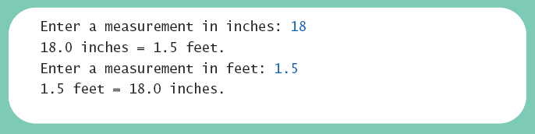
Static Methods
Result

Slide 18
Static Methods
public class StaticMethodDemo {
private int att1, att2;
public void InstanceMethod() {
System.out.println(
"This is an intance method.");
System.out.println("\tatt1 = " + att1 + ",
att2 = " + att2);
}
public static void StaticMethod() {
System.out.println(
"This is a static method.");
// static methods cannot access instance var.
// System.out.println("\tatt1 = " + att1 + ",
// att2 = " + att2); // not allowed
}
}
public class OtherClass {
public static void main(String args[]){
// calling instance method
StaticMethodDemo a =
new StaticMethodDemo();
a.InstanceMethod();
// calling static method
StaticMethodDemo.StaticMethod();
a.StaticMethod(); // also possible
}
}

Slide 19
Tasks of main in Subtasks
Program may have complicated logic or repetitive code
You may create static methods to accomplish subtasks
main cannot call instance methods because it’s a static method.
BUT it is recommended all actions (including logics) to be defined by methods in an object.
Use a main method just as an entry point of your program!!!

Slide 20
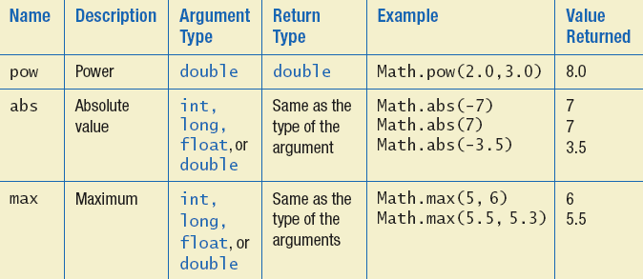
The Math Class
Provides many standard mathematical methods
Automatically provided, no import needed

Slide 21
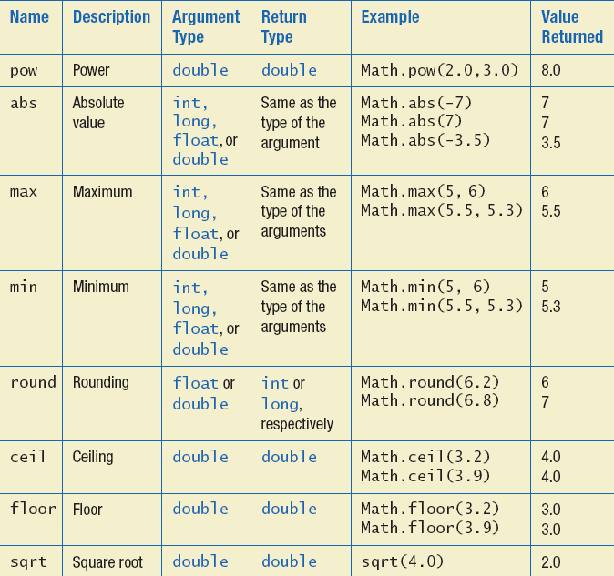
The Math Class

Slide 22
Random Numbers
Math.random() returns a random double that is greater than or equal to zero and less than 1
Can scale using addition and multiplication; the following simulates rolling a six sided die
Ex) int die = (int) (6.0 * Math.random()) + 1;
Java also has a Random class to generate random numbers

Slide 23
Wrapper Classes
Recall that arguments of primitive type treated differently from those of a class type
May need to treat primitive value as an object
Java provides wrapper classes for each primitive type
Byte, Short, Integer, Float, Double, Character, Boolean
Allow programmer to have an object that corresponds to value of primitive type
Contain useful predefined constants and methods
Wrapper classes have no default constructor
Wrapper classes have no set methods

Slide 24
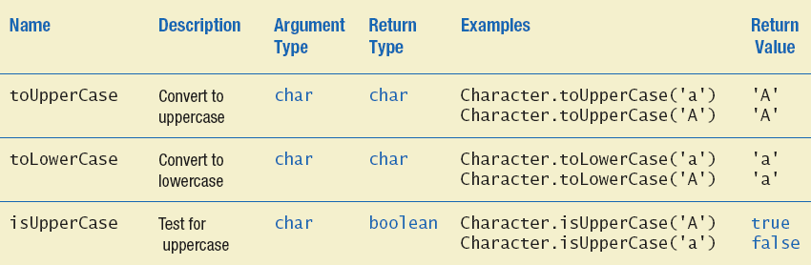
Wrapper Classes
Static methods in class Character

Slide 25
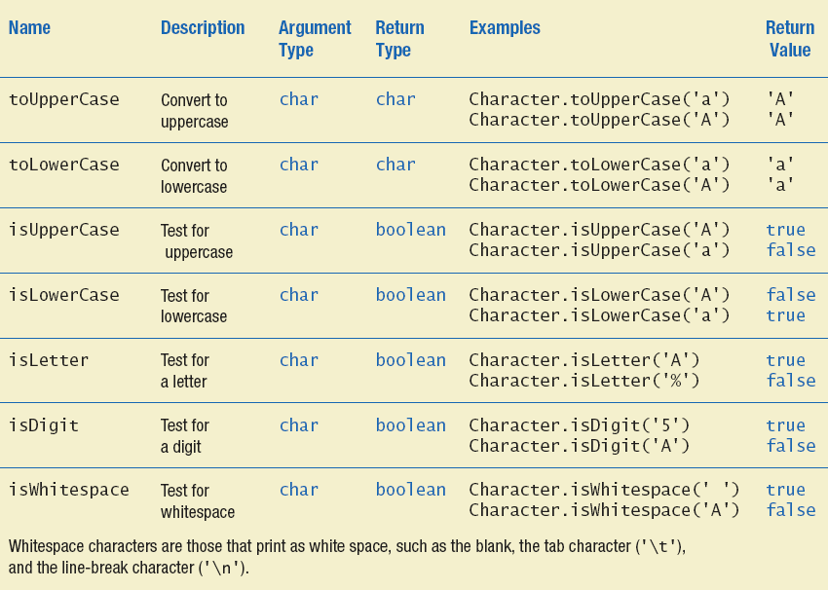
Wrapper Classes
Static methods in class Character

Slide 26
Agenda
Constructors
Static Variables and Static Methods
Writing Methods
Overloading
Enumeration As A Class
Packages

Slide 27
Formatting Output
Algorithm to display a double amount as dollars and cents
1. dollars = the number of whole dollars in amount.
2. cents = the number of cents in amount. Round if there are more than two digits after the decimal point.
3. Display a dollar sign, dollars, and a decimal point.
4. Display cents as a two-digit integer.

Slide 28
DollarFormatFirstTry
public class DollarFormatFirstTry
{
public static void write (double amount)
{
int allCents = (int) (Math.round (amount * 100));
int dollars = allCents / 100;
int cents = allCents % 100;
System.out.print ('$');
System.out.print (dollars);
System.out.print ('.');
if (cents < 10) {
System.out.print ('0');
System.out.print (cents);
} else
System.out.print (cents);
}
}

Slide 29
DollarFormatFirstTryDriver
import java.util.Scanner;
public class DollarFormatFirstTryDriver
{
public static void main (String [] args)
{
double amount;
String response;
Scanner keyboard = new Scanner (System.in);
System.out.println ("Testing DollarFormatFirstTry.write:");
do {
System.out.println ("Enter a value of type double:");
amount = keyboard.nextDouble ();
DollarFormatFirstTry.write (amount);
System.out.println ();
System.out.println ("Test again?");
response = keyboard.next ();
}
while (response.equalsIgnoreCase ("yes"));
System.out.println ("End of test.");
}
}

Slide 30
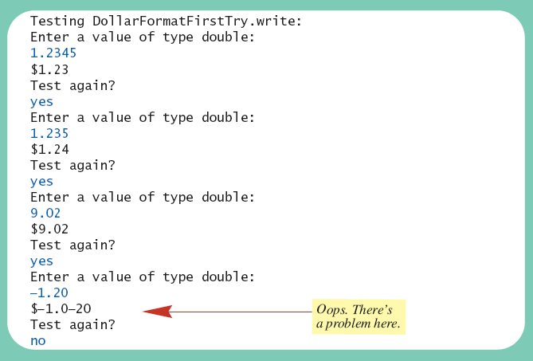
Formatting Output
Result

Slide 31
Formatting Output
class DollarFormat
Note code to handle negative values
DollarFormatFirstTryDriver will now print values correctly

Slide 32
Agenda
Constructors
Static Variables and Static Methods
Writing Methods
Overloading
Enumeration As A Class
Packages

Slide 33
Overloading Basics
Two or more methods may have the same name within the same class.
Java distinguishes the methods by number and types of parameters.
If it cannot match a call with a definition, it attempts to do type conversions.
A method's name and number and type of parameters is called the signature.
myMethod(int a, int b)
myMethod()
myMethod(double a, double b, double c)
https://en.wikipedia.org/wiki/Type_signature#Java

Slide 34

Overload
public class Overload
{
public static void main (String [] args)
{
double average1 = Overload.getAverage (40.0, 50.0);
double average2 = Overload.getAverage (1.0, 2.0, 3.0);
char average3 = Overload.getAverage ('a', 'c');
System.out.println ("average1 = " + average1);
System.out.println ("average2 = " + average2);
System.out.println ("average3 = " + average3);
}
public static double getAverage (double first, double second)
{
return (first + second) / 2.0;
}
public static double getAverage (double first, double second, double third)
{
return (first + second + third) / 3.0;
}
public static char getAverage (char first, char second)
{
return (char) (((int) first + (int) second) / 2);
}
}

Slide 35
Overloading and Type Conversion
Overloading and automatic type conversion can conflict
Remember the compiler attempts to overload before it does type conversion
Ex) The Pet class has two constructors
public Pet (int initialAge)
public Pet (double initialWeight)
If we pass an integer to the constructor we get the constructor for age, even if we intended the constructor for weight
Use descriptive method names, avoid overloading

Slide 36
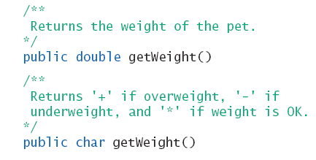
Overloading and Return Type
You must not overload a method where the only difference is the type of value returned
The signatures are the same

Slide 37
Agenda
Constructors
Static Variables and Static Methods
Writing Methods
Overloading
Enumeration As A Class
Packages

Slide 38
Enumeration as a Class
Consider defining an enumeration for suits of cards
enum Suit { CLUBS, DIAMONDS, HEARTS, SPADES }
Compiler creates a class Suit with methods
equals() – tests whether current object is the same with other object
compareTo() - compares with other Suit object. It returns a negative, zero or a positive according to the comparison result
ordinal() returns the position or the ordinal value
toString() – returns the string form such as “HEARTS”.
valueOf() – eg. Suit.valueOf(“HEARTS”) returns the object Suit.HEARTS.
For more, http://docs.oracle.com/javase/1.5.0/docs/api/java/lang/Enum.html

Slide 39
Enumeration as a Class
Enhanced Enumeration Suit
enum Suit
{
// strings as the values for the enumerated objects
CLUBS ("black"), DIAMONDS ("red"), HEARTS ("red"), SPADES ("black");
private final String color;
private Suit (String suitColor)
{
color = suitColor;
}
public String getColor ()
{
return color;
}
}

Slide 40
Agenda
Constructors
Static Variables and Static Methods
Writing Methods
Overloading
Information Hiding Revisited
Enumeration As A Class
Packages

Slide 41
Packages and Importing
A package is a named collection of classes grouped together into a folder
Name of folder is name of package
Library of classes for use in any program
Each class
Placed in a separate file
Has this line at the beginning of the file package Package_Name;
Classes use packages by use of import statement

Slide 42
Package Names and Directories
Package name tells compiler path name for directory containing classes of package
Search for package begins in class path base directory
Package name uses dots in place of / or \
Ex) CLASSPATH= .;C:\Program Files\Java\jre1.6.0_05\lib\;
CLASSPATH= .; %JAVA_HOME%\lib\;
Name of package uses relative path name starting from any directory in class path

Slide 43
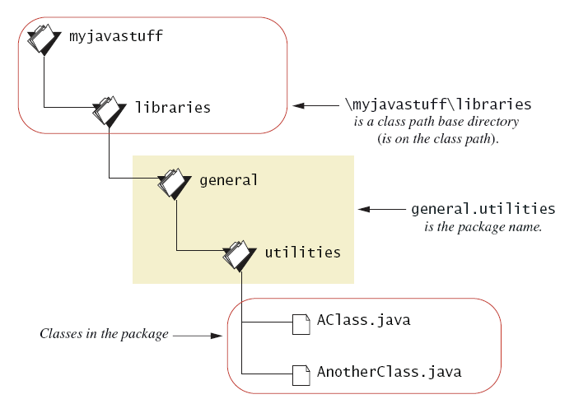
Package Names and Directories
A package name

Slide 44
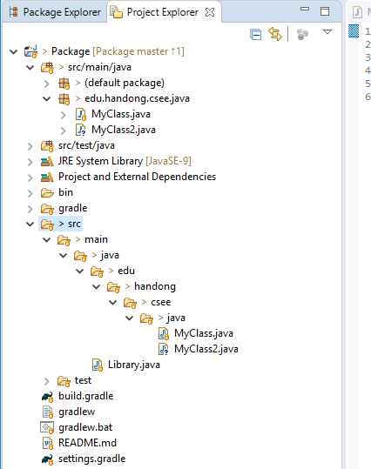
Package Names and Directories
A package directories in Project Explorer in Eclipse (Window → Show View → Project Explorer)
Base directory
Package name (edu.handong.csee.java)
Classes in the package

Slide 45
Name Clashes (conflicts)
Packages help in dealing with name clashes
When two classes have same name
Different programmers may give same name to two classes
Ambiguity resolved by using the package name

